Slide 1
CM 3.2: Probability Functions

Slide 2
The probability triple
Given a random experiment…
𝛀 | Sample space | What can possibly happen?
𝓕 | Set of events | What are the sane questions I can ask about this probability distribution?
𝐏 | Probability measure | Function that maps elements from 𝓕 to the interval [0,1]

Slide 3
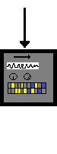
Random
Variable
Probability distribution function
𝛚
real numbers
X(𝛚) = x
probabilities
P(X(𝛚) = x)
TTHHtHT
01001000111
½ ½ ½ ½ ½

Slide 4
A function that associates an outcome with a real number.
Random Variable

Slide 5
Random
Variable
Probability distribution function
𝛚
real numbers
X(𝛚) = x
probabilities
P(X(𝛚)) = x
TTHHtHT
01001000111
½ ½ ½ ½ ½

Slide 6
Function that maps the output of a random variable to the interval
[0, 1] in probability space.
Probability Distribution Function

Slide 7
Discrete or continuous?
A continuous rv can take any value in an interval or collection of intervals
A discrete rv can take one of a countable list of distinct values
Different things → different math required

Slide 8
pmf or pdf?
Every discrete rv has a probability mass function (pmf)
Every continuous rv has a probability density function (pdf)
Different ways of defining the function that says how probable an event is.

Slide 9
Discrete rv
Remember X is our random variable
We feed it all the 𝛚_{1, 2, …k} and it transforms each simple event into a value, call that x_{1, 2, …k}
Now each of these values is fed to the probability distribution function, which takes these x_{1, 2, …k} and tallies the number of values it sees, then divides by the total, such that we now have P(X = x_{k})
So far we have only seen this as a column in a table, but it is a function! P(X = x_{k}) = f(x_{k})
Called the probability mass function (pmf)
What must be true about this function?

Slide 10
Random
Variable
Probability distribution function
𝛚_{1, 2, …k}
real numbers
X(𝛚) = x_{1, 2, …k}
probabilities
P(X(𝛚) = x)
TTHHtHT
01001000111
½ ½ ½ ½ ½

Slide 12
For discrete X, f(x) is a
Probability Mass Function*
*It gives you a probability! (always between 0 to 1)

Slide 13
Which of these is a pmf?
✗
✗
x | f(x)
-1 | 0.3
0 | 0.3
2 | 0.3
x | f(x)
10 | -0.1
20 | 0.9
30 | 0.2
x | f(x)
1 | 0.35
2 | 0.25
3 | 0.2
4 | 0.1
5 | 0.1
x | f(x)
10 | 0.1
20 | 0.9
30 | 0.2
✗
x | f(x)
5 | 1

Slide 14
What does a pmf look like?
Table/list of numbers
Rows = x_{1, 2, …k}
Function (large n)
A plot
x-axis?
y-axis?

Slide 15
Bernoulli rv
Special type of simple discrete rv
Two possible outcomes: success (X = 1) or failure (X = 0)
P(1) = p
P(0) = 1- p

Slide 16
Sequences of independent Bernoulli trials → other special types of discrete rvs with discrete distributions
Distribution | Definition
Binomial | Number of successes in n trials
Negative binomial | Number of failures before the x-th success
Geometric | Number of failures before the 1st success

Slide 17
Notation
The tilde or twiddle: “~”
English: “is distributed as”
X ~ DistributionName(parameters)
Coin tossing example: X ~ Bin(n, p)
English: rv X is distributed as a binomial rv with…
n number of trials and*…
p as the single trial probability of success
*n here can be number of coins tossed, or you could have 1 coin tossed n times

Slide 18



X(𝛚)
probability
H
T
1
.25
n = ?
p = ?
T
H
1
.25
𝛀
H
H
2
.25
T
T
0
.25

Slide 19
X(𝛚)
probability
H
T
1
.25
n = 2 (not an rv!)
p = .5 (parameter!)
T
H
1
.25
𝛀
H
H
2
.25
T
T
0
.25

Slide 20
X ~ Bin(2, .5): 1 experiment
In R, rbinom(number of experiments (n), number of trials per experiment (size), probability of success (prob). We’ll start with one experiment (flipping 2 coins once):
> num_exp <- 1
> num_trials <- 2
> p <- .5
> rbinom(num_exp, num_trials, p)
[1] 2
> rbinom(num_exp, num_trials, p)
[1] 0
> rbinom(num_exp, num_trials, p)
[1] 1
A little boring- but seems to work!
Let’s try flipping 2 coins 10 times…

Slide 21
X ~ Bin(2, .5): 10 experiments
> num_exp <- 10
> num_trials <- 2
> x <- rbinom(num_exp, num_trials, .5)
> length(x)
[1] 10
> table(x)
x
0 1 2
1 6 3
x | Expected P(x) | Observed P(x)
0 | 25% | 10%
1 | 50% | 60%
2 | 25% | 30%

Slide 22
X ~ Bin(2, .5): 1,000 experiments
> num_exp <- 1000
> num_trials <- 2
> x <- rbinom(num_exp, num_trials, .5)
> length(x)
[1] 1000
> table(x)
x
0 1 2
234 512 254
x | Expected P(x) | Observed P(x)
0 | 25% | 23.4%
1 | 50% | 51.2%
2 | 25% | 25.4%

Slide 23
Let X now count the number of heads (k) in n = 30 independent coin flips…
In R:
x <- rbinom(num_exp, 2, .5)
In R:
k <- rbinom(num_exp, 30, .5)
What is the range of k?

Slide 24
Binomial pmf: f_{X}(k; n, p) (equivalent notation)

Slide 25
How many ways are there to get k heads? (combination)
How likely is any particular combination of k heads and n - k tails? (multiplicative rule)
When we use the Binomial distribution we know p and n and the distribution describes the probabilities for all the ks we could have.

Slide 26
X ~ Bin(30, .5): 1 experiment, 30 flips
The distribution that describes the number of heads (k) after n tosses of a fair coin. Given that we have n = 30 trials, and we want k heads, and the probability of getting a head is p = .5, the probability of each k is:
Now we can ask about the probability for any k!
> k <- rbinom(1, 30, .5)
> k # in my 1 experiment, I got 17 heads
[1] 17

Slide 27
In R…
R function | Discrete RV | Continuous RV
r | Generates random deviates
d | Probability (pmf) | Probability density (pdf)
p | Cumulative probability (cdf)
q | Inverse cumulative probability (quantiles)

Slide 28

Questions we can ask the pmf
"What is the probability of getting exactly 17 heads?” 0.112
"What is the probability of getting 18 to 24 heads?” 0.181
"What is the probability that the number of heads ends in 7?” 0.113
"What is the probability of getting 1.5 heads?” Huh?

Slide 29
Questions we can ask the pmf in R
"What is the probability of getting exactly 17 heads?” 0.112
dbinom(17, 30, .5)
"What is the probability of getting 18 to 24 heads?” 0.181
sum(dbinom(18:24, 30, .5))
"What is the probability that the number of heads ends in 7?” 0.113
sum(dbinom(c(7, 17, 27), 30, .5))
"What is the probability of getting 1.5 heads?” Huh?
Warning message:
In dbinom(1.5, 30, 0.5) : non-integer x = 1.500000

Slide 30
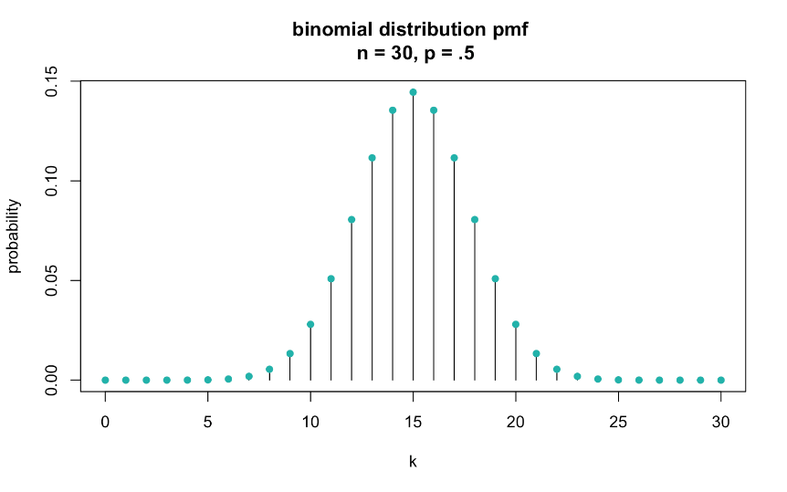
Before we peek:
What will be the center of this distribution?
What will be the shape: mode(s), skewness?

Slide 32
For all X, F(x) is a
Cumulative Distribution Function

Slide 33
Discrete rv: cumulative distribution function
(since x is used as a variable in the summation, we use “t” just as some other variable)

Slide 34
Cumulative distribution function

Slide 37
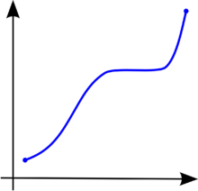
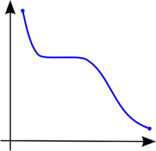
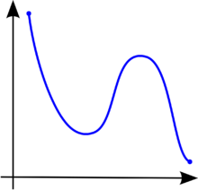
✗
✗

Slide 38
Let X count the number of heads (k) in n independent coin flips (again)…

Slide 39
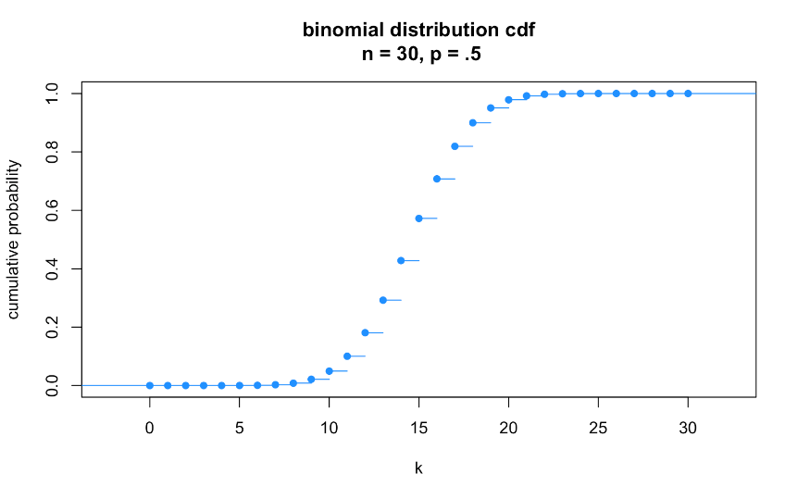
Before we peek:
What is the range on the y-axis?
Will it be smooth? Mound-shaped?
median (Q2) = 15

Slide 40
median (Q2) = 15
> qbinom(.5, 30, .5) #Q2 (median)
[1] 15

Slide 41
Q3: ≈17
Q1: ≈13
> qbinom(.25, 30, .5) #Q1
[1] 13
> qbinom(.75, 30, .5) #Q3
[1] 17

Slide 42

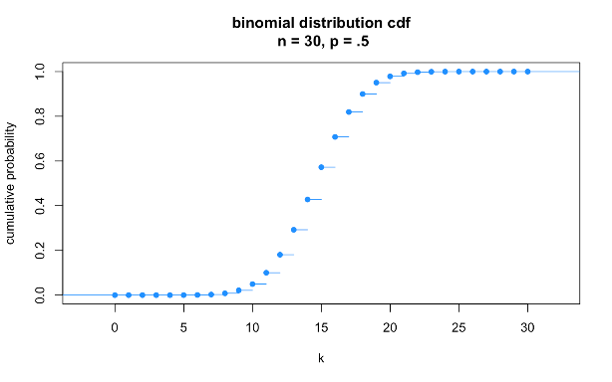
cumulative sum

Slide 43

Expectation of a
discrete random variable

Slide 44
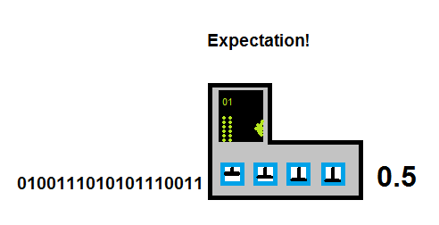
Expectation
The expectation of a random variable (X) is the sum of its values (x_{i}) weighted by their probability (p_{i}).
Output from random variable
Single number

Slide 45
Expectation: Toss a fair coin 2 times

Slide 46

x
P(x)
E(x)
H
1 × .5
.5
H
H
2 × .25
.5
0 × .25
0
E(X)
1.0

Slide 47
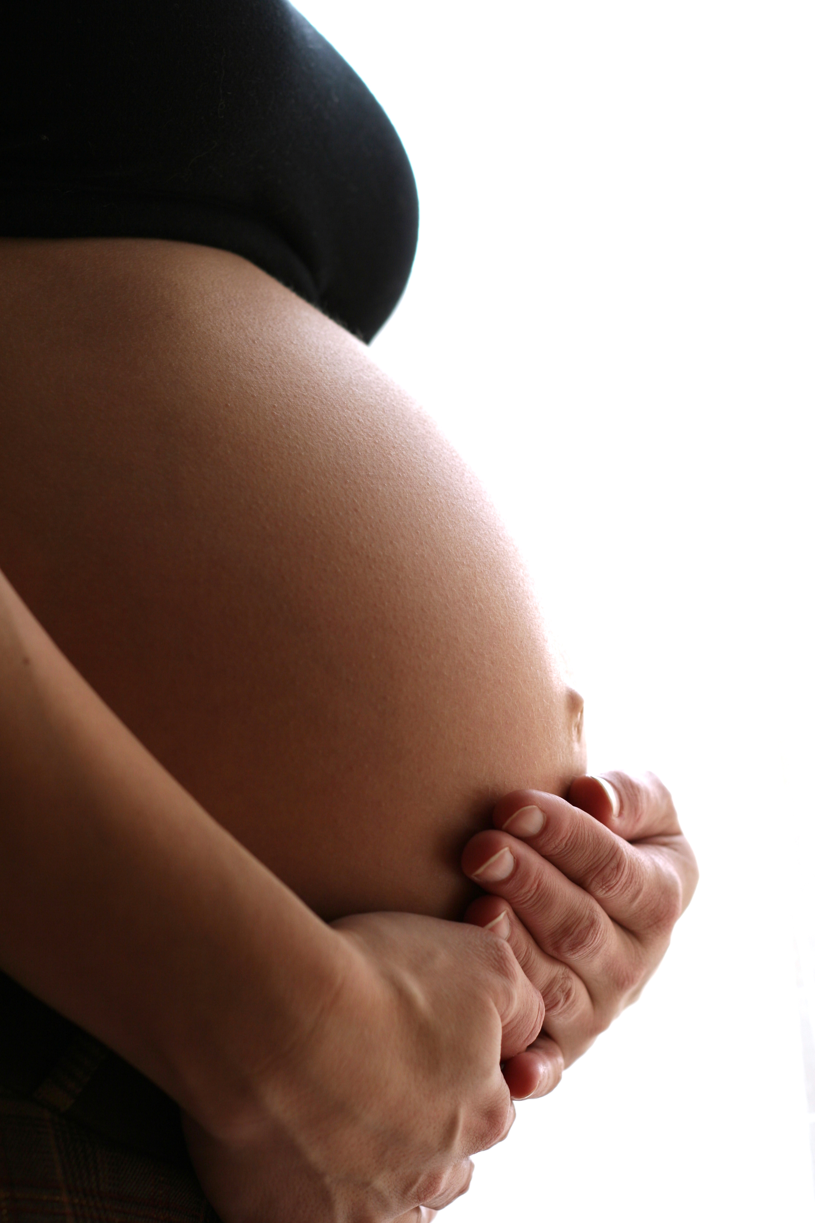
Expected values
The expected value estimates the population mean, 𝜇_{X}, for an rv with a given distribution
Example: families with fraternal twins
Random variable X: # of girls (discrete!)
Population: all families with fraternal twins
Expected value: the mean number of girls per families across all families with fraternal twins
Given that boys and girls are equally likely, what is 𝜇_{X}?

Slide 48

x
P(x)
E(x)
1 × .5
.5
2 × .25
.5
0 × .25
0
E(X)
1.0

Slide 49
Expected values: discrete distributions
Population mean
𝜇_{X}
pmf
For binomial, plug in pmf:
n = 2
p = .5

Slide 50
Expected value of a binomial rv: the long way
= 0
= 1/2
= 1/2
R can help:
> choose(2,0)
[1] 1
> choose(2,1)
[1] 2
> choose(2,2)
[1] 1

Slide 51
Population variance for discrete rv
The variance is the expected value of the square of the deviation of X from its own mean

Slide 52
Population variance for discrete rv
The variance is the expected value of the square of the deviation of X from its own mean
pmf →
probabilities!

Slide 53
Expected value of a binomial rv: the short way

Slide 54
Expected values
If you sample from a distribution, and your sample is sufficiently large, then you have a reasonable expectation that your sample mean will be close to the population mean
We can calculate the expected value for the underlying distribution and use this to form hypotheses about our current sample

